Slide 1
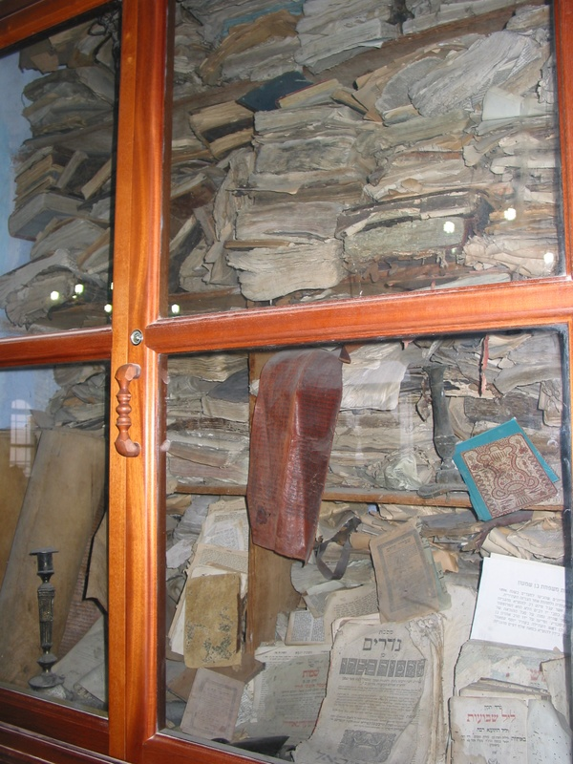
U M L S
HVN 11
HL7
SNOMED
DEMONS

Slide 2
Clinical Coding and Terminologies:
The Good, the Bad and the Mostly Ugly
Barry Smith
http://ontology.buffalo.edu/smith

Slide 3
U M L S
HVN 11
HL7
SNOMED
DEMONS

Slide 4
ad hoc creation of new terminologies by each separate community
UMLS open-door policy for admission
Many of these terminologies remain as torsos, gather dust, poison the wells, ...

Slide 5
The Good
Foundational Model of Anatomy (FMA)
Pro
clear statement of scope: structural human anatomy, at all levels of granularity, from the whole organism to the biological macromolecule
Powerful treatment of definitions, from which the entire FMA hierarchy is generated – can serve as basis for formal reasoning
Con
Some unfortunate artifacts in the ontology deriving from its specific computer representation (Protégé)

Slide 6
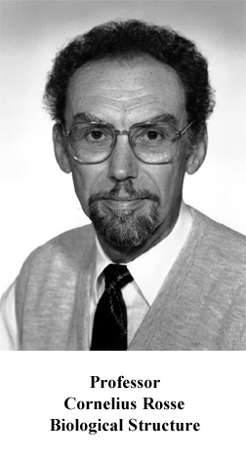
It’s Better Manually

Slide 7
Anatomical Space
Anatomical
Structure
Organ Cavity
Subdivision
Organ
Cavity
Organ
Organ Part
Serous Sac
Cavity
Subdivision
Serous Sac
Cavity
Serous Sac
Organ
Component
Organ
Subdivision
Tissue
is_a
Pleural Sac
Pleura(Wall
of Sac)
Pleural
Cavity
part_of
Parietal
Pleura
Visceral
Pleura
Interlobar
recess
Mediastinal
Pleura
Mesothelium
of Pleura

Slide 8
The Foundational Model of Anatomy
Follows formal rules for ‘Aristotelian’ definitions
When A is_a B, the definition of ‘A’ takes the form:
an A =def. a B which ...
a human being =def. an animal which is rational

Slide 9
FMA Example
Cell =def. an anatomical structure which consists of cytoplasm surrounded by a plasma membrane with or without a cell nucleus
Plasma membrane =def. a cell part that surrounds the cytoplasm

Slide 10
The FMA regimentation
Each definition reflects the position in the hierarchy to which a defined term belongs.
The entire information content of the is_a hierarchy can be translated very cleanly into a computer representation

Slide 11
Intermediate
GALEN
Pro
Allows formal representation of clinical information
Allows multiple views of relevant detail as needed
Uses powerful Description Logic (DL)-based formal structure
Makes definitions easy to formulate
Con
Remains only partially developed
Contains errors: Vomitus contains carrot
– which DL-structure did not prevent

Slide 12
Principle
An ontology should not remain a torso

Slide 13
Principle
An ontology should have procedures for up-dating in light of scientific advance

Slide 14
The Bad
Reactome
Pro
Rich catalogue of biological process
Con
Incoherent treatment of categories:
ReferentEntity (embracing e.g. small molecules) is a sibling of PhysicalEntity (embracing complexes, molecules, ions and particles).
Similarly CatalystActivity is a sibling of Event.

Slide 15
Principle
An ontology should be in agreement with the truths of basic science (e.g. that molecules are physical entities)

Slide 16
The Ugly
ICD-10
Other accidental submersion or drowning in water transport accident injuring other specified person
Accident to powered aircraft, other and unspecified, injuring occupant of military aircraft, any rank
Other accidental submersion or drowning in water transport accident injuring occupant of other watercraft - crew

Slide 17
The Ugly
ICD-10
Tuberculosis of unspecified bones and joints, tubercle bacilli not found by bacteriological or histological examination, but tuberculosis confirmed by other methods (inoculation of animals)

Slide 18
The Ugly
ICD-10
Fall on stairs or ladders in water transport injuring occupant of small boat, unpowered
Railway accident involving collision with rolling stock and injuring pedal cyclist
Nontraffic accident involving motor-driven snow vehicle injuring pedestrian

Slide 19
The Ugly
International Classification of Diseases
Fitting and adjustment of wheelchair
Hot (boiling) tap water
Training in use of lead dog for the blind
Person consulting on behalf of another person

Slide 20
Principle
An ontology should have a clearly specified domain (captured by its root node)

Slide 21
The Ugly
MeSH
National Socialism is_a Political Systems
National Socialism is_a Anthropology ...

Slide 22
Principle
Use singular nouns

Slide 23
MeSH
MeSH Descriptors
Index Medicus Descriptor
Anthropology, Education, Sociology and
Social Phenomena (MeSH Category)
Social Sciences
Political Systems
National Socialism
National Socialism is_a Political Systems
National Socialism is_a Anthropology ...

Slide 24
MeSH
National Socialism is_a MeSH Descriptor

Slide 25
Principle
Avoid the confusion of use and mention
Swimming is healthy and has 8 letters

Slide 26
Principle
Don’t confuse an entity with the name of an entity

Slide 27
Principle
Avoid circular definitions
(The term defined should not appear in its own definition)

Slide 28
BIRNLex
mouse =def.
common name for the species mus musculus

Slide 29
ICNP: International Classification of Nursing Procedures
water =def. a type of Nursing Phenomenon of Physical Environment with the specific characteristics: clear liquid compound of hydrogen and oxygen that is essential for most plant and animal life influencing life and development of human beings.

Slide 30
Principle
For the sake of interoperability with other ontologies, do not give special meanings to terms with established general meanings
(Don’t use ‘cell’ when you mean ‘plant cell’)

Slide 31
MORE UGLY
National Cancer Institute Thesaurus (NCIT)

Slide 32
The NCIT reflects a recognition of the need
for high quality shared ontologies and terminologies the use of which by clinical researchers in large communities can ensure re-usability of data collected by different research groups

Slide 33
NCIT
“a biomedical vocabulary that provides consistent, unambiguous codes and definitions for concepts used in cancer research”
“exhibits ontology-like properties in its construction and use”.

Slide 34
Verbal Definitions
About half the NCIT terms are assigned verbal definitions
Unfortunately some are assigned more than one

Slide 35
Disease Progression
Definition1
Cancer that continues to grow or spread.
Definition2
Increase in the size of a tumor or spread of cancer in the body.
Definition3
The worsening of a disease over time. This concept is most often used for chronic and incurable diseases where the stage of the disease is an important determinant of therapy and prognosis.

Slide 36
Principle
Each term should have at most one definition*
*which may have both natural-language and formal versions

Slide 37
Disease Progression has as subclass:
Cancer Progression
Definition:
The worsening of a cancer over time. This concept is most often used for incurable cancers where the stage of the cancer is an important determinant of therapy and prognosis.

Slide 38
Cancer
a process (of getting better or worse)
an object (which can grow and spread)

Slide 39
Two kinds of entities
occurrents (processes, events, happenings)
cell division, ovulation, death
continuants (objects, qualities, ...)
cell, ovum, organism, temperature of organism, ...

Slide 40
Principle
Distinguish continuant entities (molecule, cell, tumor, organism) from occurrent entities (processes of growth, change, ...)

Slide 41
NCIT confuses definitions with descriptions
Tuberculosis
Definition
A chronic, recurrent infection caused by the bacterium Mycobacterium tuberculosis. Tuberculosis (TB) may affect almost any tissue or organ of the body with the lungs being the most common site of infection. The clinical stages of TB are primary or initial infection, latent or dormant infection, and recrudescent or adult-type TB. Ninety to 95% of primary TB infections may go unrecognized. Histopathologically, tissue lesions consist of granulomas which usually undergo central caseation necrosis. Local symptoms of TB vary according to the part affected; acute symptoms include hectic fever, sweats, and emaciation; serious complications include granulomatous erosion of pulmonary bronchi associated with hemoptysis. If untreated, progressive TB may be associated with a high degree of mortality. This infection is frequently observed in immunocompromised individuals with AIDS or a history of illicit IV drug use.

Slide 42
Confuses definitions with descriptions
Tuberculosis
Definition
A chronic, recurrent infection caused by the bacterium Mycobacterium tuberculosis. Tuberculosis (TB) may affect almost any tissue or organ of the body with the lungs being the most common site of infection. The clinical stages of TB are primary or initial infection, latent or dormant infection, and recrudescent or adult-type TB. Ninety to 95% of primary TB infections may go unrecognized. Histopathologically, tissue lesions consist of granulomas which usually undergo central caseation necrosis. Local symptoms of TB vary according to the part affected; acute symptoms include hectic fever, sweats, and emaciation; serious complications include granulomatous erosion of pulmonary bronchi associated with hemoptysis. If untreated, progressive TB may be associated with a high degree of mortality. This infection is frequently observed in immunocompromised individuals with AIDS or a history of illicit IV drug use.

Slide 43
A better definition
Tuberculosis
Definition:
A chronic, recurrent infection caused by the bacterium Mycobacterium tuberculosis.

Slide 44
Duratec, Lactobutyrin, Stilbene Aldehyde
are classified by the NCIT as Unclassified Drugs and Chemicals

Slide 45
Problematic synonyms
Anatomic Structure, System, or Substance ~ Anatomic Structures and Systems
Does ‘anatomic’ apply only to structure or also to system and substance?
Biological Function ~ Biological Process
some biological processes are the exercises of biological functions
others (e.g. pathological processes, side effects) not
Genetic Abnormality ~ Molecular Abnormality (with subtype: Molecular Genetic Abnormality) (definitions not supplied)

Slide 46
Three disjoint classes of plants
  Vascular Plant
  Non-vascular Plant
  Other Plant

Slide 47
Three kinds of cells
Abnormal Cell is a top-level class (thus not subsumed by Cell
Normal Cell is a subclass of Microanatomy.
Cell is a subclass of Other Anatomic Concept (so that cells themselves are concepts)

Slide 48
NCIT as now constituted will block automatic reasoning
Neither Normal Cells nor Abnormal Cells are Cells within the context of the NCIT

Slide 49
Some consolations
NCIT is open source
NCIT has broad coverage
NCIT has some formal structure (OWL-DL)
NCIT is much, much better than (for example) the HL7-RIM
NCIT has realized the errors of its ways

Slide 50
What might have been
http://www.cbd-net.com/index.php/search/show/938464
= “Review of NCI Thesaurus and Development of Plan to Achieve OBO Compliance”

Slide 51
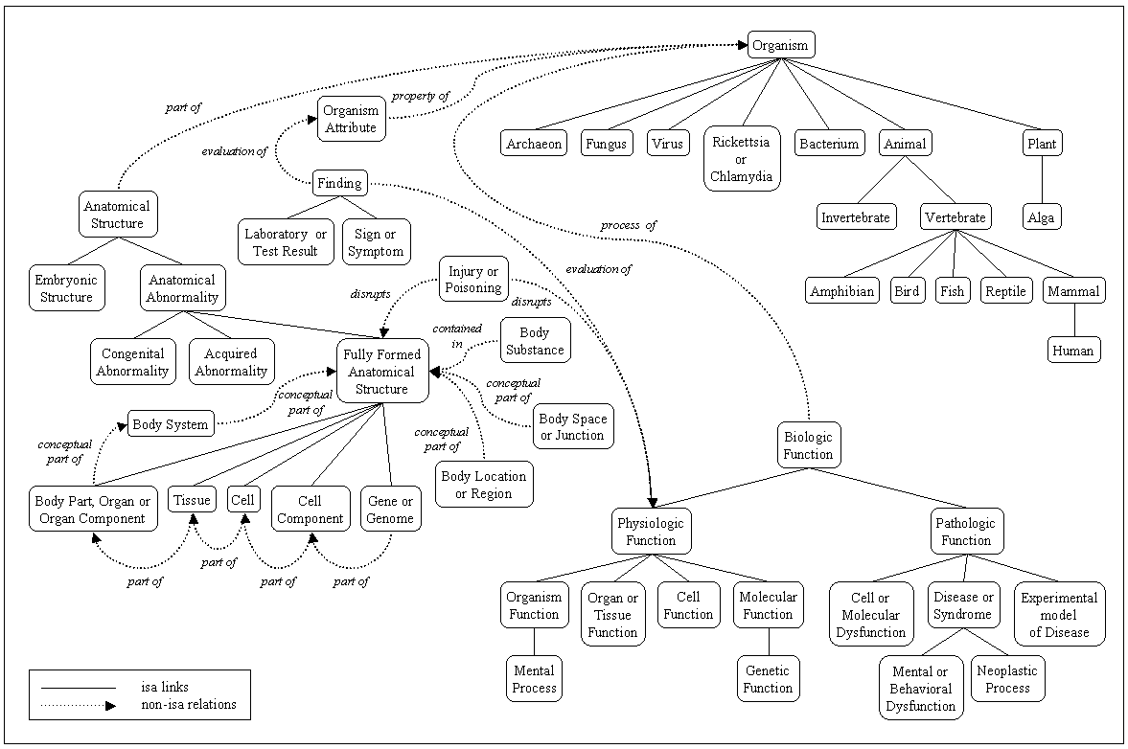
The UMLS Semantic Network

Slide 52
More Ugly
UMLS Semantic Network
Pros
Broad coverage; no multiple inheritance
Cons
Incoherent use of ‘conceptual entities’
(e.g. the digestive system as a conceptual part of the organism)
Full of errors

Slide 53
UMLS Semantic Network
Edges in the graph represent merely “possible significant (= some-some) relations”:
  Bacterium causes Experimental Model of Disease
  Experimental Model of Disease affects Fungus
  Experimental model of disease is_a Pathologic Function

Slide 54
UMLS Semantic Network
Unclear what the nodes of the graph are:
Drug Delivery Device contains Clinical Drug
Drug Delivery Device narrower_in_meaning_than Manufactured Object
The use-mention confusion again

Slide 55
a pudding of ‘concepts’

Slide 56
location_of
Fungus location_of Vitamin
Tissue location_of Mental or Behavioral Dysfunction

Slide 57
Fungus location_of Vitamin
Every instance of vitamin is located in some fungus?
Some instances of vitamin are located in some fungi?
Some instances of fungi have instances of vitamin located in them?
Every instance of vitamin is located in every instance of fungus?

Slide 58
what are the nodes in this graph?

Slide 60
Conceptual Entities =def
An organizational header for concepts representing mostly abstract entities.
Includes as subtypes:
action, change, color, death, event, fluid, injection, temperature

Slide 61
The UMLS Metathesaurus
Unified Medical Language System Metathesaurus
is very useful
but it is not unified, and it is not a system

Slide 62
above all the UMLS Metathesaurus is not an ontology

Slide 63
is_a (sensu UMLS)
A is_a B =def
‘A’ is narrower in meaning than ‘B’
grows out of the heritage of dictionaries, which reflect meanings, not biological reality

Slide 64
Concepts, Concept Names, and their Identifiers in the UMLS
The Metathesaurus is organized by concept. One of its primary purposes is to connect different names for the same concept from many different vocabularies.
Notes:
http://www.nlm.nih.gov/research/umls/meta2.html

Slide 65
The desperate search for ‘mappings’
A concept is a meaning. A meaning can have many different names. A key goal of Metathesaurus construction is to understand the intended meaning of each name in each source vocabulary and to link all the names from all of the source vocabularies that mean the same thing (the synonyms).
Notes:
http://www.nlm.nih.gov/research/umls/meta2.html

Slide 66
The desperate search for ‘mappings’
This is not an exact science. ... Metathesaurus editors decide what view of synonymy to represent in the Metathesaurus concept structure. Please note that each source vocabulary’s view of synonymy is also present in the Metathesaurus, irrespective of whether it agrees or disagrees with the Metathesaurus view.
Notes:
http://www.nlm.nih.gov/research/umls/meta2.html

Slide 67
These strange mapping
between names as they appear in different source vocabularies created for widely different purposes can still be very useful
but the source vocabularies themselves are of variable quality
(not all mappings are created equal)
and the sorts of search which the UMLS supports reflects an already outmoded technology

Slide 68
is_a (sensu UMLS)
congenital absent nipple is_a nipple
surgical procedure not carried out because of patient’s decision is_a surgical procedure
cancer documentation is_a cancer
disease prevention is_a disease
living subject is_a information object representing an animal or complex organism
individual allele is_a act of observation
limb is_a tissue

Slide 69
is_a (sensu UMLS)
both testes is_a testis
plant leaves is_a plant
smoking is_a individual behavior
walking is_a social behavior

Slide 70
The really ugly

Slide 71
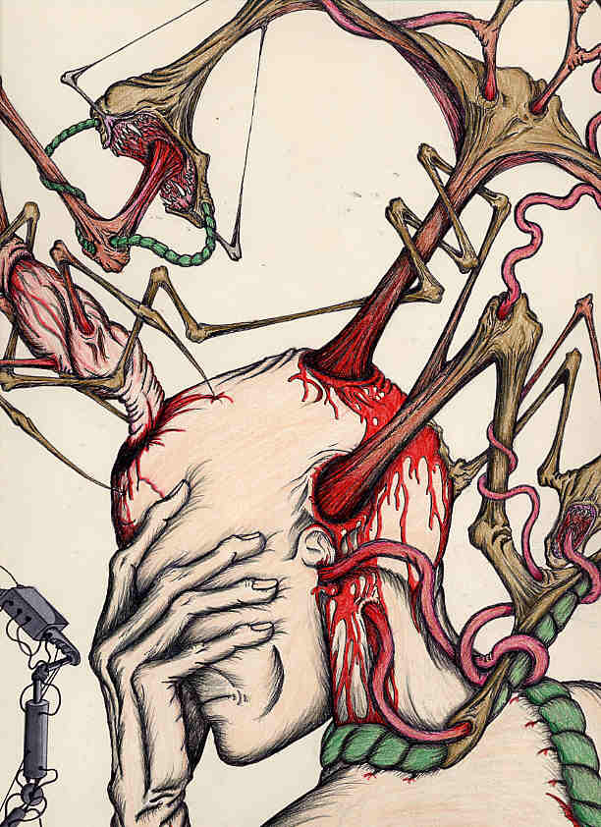

Slide 72
HL7
HL7
HVN 11

Slide 73
HL7 Marketing
HL7 V3 claims to be:
“The foundation of healthcare interoperability”
“The data standard for biomedical informatics”
from blood banks to Electronic Health Records to clinical genomics

Slide 74
HL7 Incredibly Successful
adopted by Oracle as basis for its Electronic Health Record technology; supported by IBM, GE, Sun ...
embraced as US federal standard
central part of $25+ billion program to integrate all UK hospital information systems

Slide 75
HL7 Watch
http://hl7-watch.blogspot.com/

Slide 76
Why V3 ?
in HL7 V2 the realization of the messaging task allows ad hoc interpretations of the standard by each sending or receiving institution.
Result: vendor products were never properly interoperable, and always require mapping software.

Slide 77
The solution to this problem (V3) is the HL7 RIM
or Reference Information Model
= a world standard for exchange of information between clinical information systems

Slide 78
The V3 solution
Remove optionality by having the RIM serve as a master model of all health information, from blood banks to Electronic Health Records to clinical genomics

Slide 79
The hype
“HL7 V3 is the standard of choice for countries and their initiatives to create national EHR and EHR data exchange standards as it provides a level of semantic interoperability unavailable with previous versions and other standards. Significant V3 national implementations exist in many countries, e.g. in the UK (e.g. the English NHS), the Netherlands, Canada, Mexico, Germany and Croatia.”

Slide 80
The reality (I asked them)
“None of the implementations have a national scope” (e.g. Stockholm City Council)

Slide 81
The hype
The RIM is “credible, clear, comprehensive, concise, and consistent”
It is “universally applicable” and “extremely stable”

Slide 82
The reality
HL7 V3 documentation is 542,458 KB, divided into 7,573 files
It remains subject to frequent revisions
It is very difficult to understand

Slide 83
The reality
The decision to adopt the RIM was made already in 1996, yet the promised benefits of interoperability still, after 10 years, remain elusive.
HL7 has bet the farm on the RIM – technology has advanced in these 10 years

Slide 84
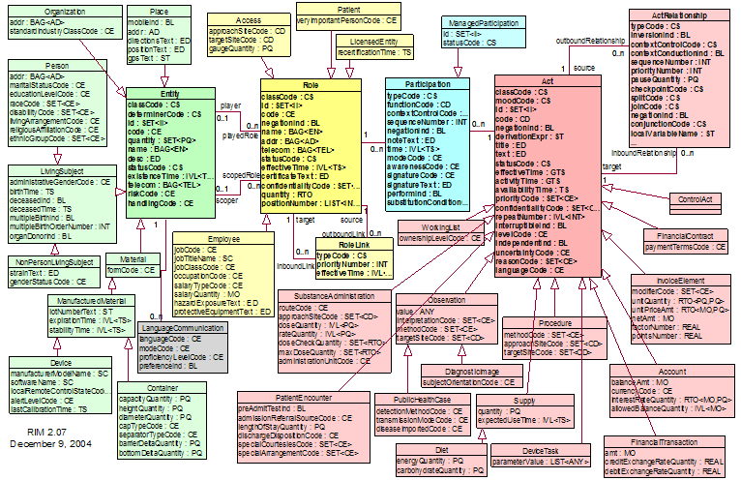
RIM NORMATIVE CONTENT

Slide 85
Too many combinations
as the traffic on HL7’s own vocabulary mailing list reveals, there is no adequate mechanism for ensuring that the vast number of combinations of coded terms within actual messages can be controlled in such a way that messages will be understood in the same way by designers, senders and receivers.

Slide 86
RIM NORMATIVE CONTENT

Slide 88
These pre-defined attributes
code, class_code, mood_code,
status_code, etc.
yield a combinatorial explosion:
class_code (61 values) x mood_code (13 values) x code (estimate 200) x status_code (10 codes) = 1.58 million combinations.
Adding in the other codes this becomes 810 billion.
Notes:
with thanks to Thomas Beale of Ocean Informatics

Slide 89
Why does the RIM embody so many combinations?
To ensure in advance that everything can be said in conformity to the standard

Slide 90
The RIM methodology
defines a set of ‘normative’ classes (Act, Role, and so on), with which are associated a rich stock of attributes from which one must make a selection when applying the RIM to each new domain (pharmacy, clinical genomics ...),
Compare: attempting to create manufacturing software by drawing from a store containing pre-established parts (so that the store would need to have the bits needed for making every conceivable manufacturable thing, be it a lawnmower, a refrigerator, a hunting bow, and so on).

Slide 91
The RIM methodology
are there examples where a methodology of this sort has been made to work?

Slide 92
This methodology does not impede the formation of local dialects
Different teams produce different message designs for the very same topic.
In the UK, the £ 35 bn. NHS National Program “Connecting for Health” has applied the RIM rigorously, using all the normative elements, and it discovered that it needed to create dialects of its own to make the V3-based system work for its purposes (it still does not work)

Slide 93
The RIM documentation
is subject to multiple and systematic internal inconsistencies and unclarities:
is marked by sloppy and unexplained use of terms such as ‘act’, ‘Act’, ‘Acts’, ‘action’, ‘ActClass’ ‘Act-instance’, ‘Act-object’
and uncertain cross-referencing to other HL7 documents
no publicly available teaching materials (no HL7 for Dummies)

Slide 94
from HL7 email forum (do not circulate)
“I am ... frightened when I contemplate the number of potential V3ers who ... simply are turned away by the difficulty of accessing the product.
“Some of them attend V3 tutorials which explain V3 as the hugely complex process of creating a message and are turned off. [They] simply do not have the stamina, patience, endurance, time, or brain-cells to understand enough for them to feel comfortable contributing to debates / listserves, etc., so they remain silent.”

Slide 95
Problems of scope
Only two main classes in the RIM
Act = roughly: intentional action
Entity = persons, places, organizations, material
How can the RIM deal transparently with information about, say, disease processes, drug interactions, wounds, accidents, bodily organs, documents?

Slide 96
Diseases in the RIM
... are not Acts
... are not Entities
... are not Roles, Participations ...
So what are they?
At best: a case of pneumonia is identified as the Act of Observation of a case of pneumonia
Note: RIM’s treatment of SNOMED codes

Slide 97
Mayo RIM discussion of the meaning of ‘Act’ as “intentional action”
Is a snake bite or bee sting an "intentional action"?
Is a knife stabbing an intentional action?
Is a car accident an intentional action?
When a child swallows the contents of a bottle of poison is that an intentional action?
Notes:
http://informatics.mayo.edu/wiki/index.php/Intentionality_of_Act_and_the_Future_of_Observations

Slide 98
The RIM has no coherent criteria for deciding
For this reason, too, dialects are formed – and the RIM does not do its job. One health information system might conceive snakebites and gunshots as Procedures of Substance Admin9stration.
Another might treat them as Observations (!).
If basic categories cannot be agreed upon for common phenomena like snakebites, then the RIM is in serious trouble.

Slide 99
The RIM’s Entity class
persons, places, organizations, material

Slide 100
What is a disease in HL7 V3
Disease = the Observation of a disease
(Diseases are Acts)

Slide 101
Are definitions like this a good basis for achieving semantic interoperability in the biomedical domain?:
LivingSubject
Definition: A subtype of Entity representing an organism or complex animal, alive or not.

Slide 102
Person (from HL7 Glossary)
Definition: A Living Subject representing single human being [sic] who is uniquely identifiable through one or more legal documents

Slide 103
The Problem of Circularity
A Person =def. A person with documents
‘An A is an A which is B’
– useless in practical terms, since neither we nor the machine can use it to find out what ‘A’ means
– incorporates a vicious infinite regress
– has the effect of making it impossible to refer to A’s which are not Bs, for example to undocumented persons

Slide 104
What is the RIM about?
blood pressure measurement = an information item
blood pressure = something in reality which exists independently of any recording of information, and which the measurement measures
Q: Is the RIM about information, or about the reality to which such information relates?
A: There is no difference between the two

Slide 105
RIM Philosophy
“The truth about the real world is constructed through a combination and arbitration of attributed statements ...
“As such, there is no distinction between an activity and its documentation.”

Slide 106
From the perspective of the RIM on the Information Model conception
  ‘medication’ does not mean: medication
  rather it means:
  the record of medication in an information system
  ‘stopping a medication’ does not mean: stopping a medication
  rather it means:
  change of state in the record of a Substance Administration Act from Active to Aborted

Slide 107
The RIM’s Entity class
persons, places, organizations, material

Slide 108
States of Entity
• active: The state representing the fact that the Entity is currently active.
• nullified: The state representing the termination of an Entity instance that was created in error.
• inactive: The state representing the fact that an entity can no longer be an active participant in events.
• normal: The “typical” state. Excludes “nullified”, which represents the termination state of an Entity instance that was created in error

Slide 109
Persons are Entities
What do ‘active’ and ‘nullifed’ mean as applied to Person?
Is there a special kind of death-through-nullification in the case of those instances of Person who were created in error?

Slide 110
HL7 Glossary
Definition of Animal: A subtype of Living Subject representing any animal-of-interest to the Personnel Management domain.
An Animal is not an animal. Rather (an) Animal represents an animal: it is an information item which represents a certain highly specific kind of animal-of-interest, namely an animal that is of interest to the Personnel Management domain.

Slide 111
Double Standards
The RIM is a confusion of two separate artifacts:
1. an “information model”, relating to names of persons, records of observations, social security numbers, etc.
2. a reference ontology, relating to persons, observations, documents, acts, etc.

Slide 112
What’s gone wrong?
People of good will are making mistakes because of insufficient concern for clarity and consistency
Even large ontologies are built in the spirit of the amateur hobbyist
Money is wasted on megasystems that cannot be used

Slide 113
Lessons for Semantic Interoperability
Clear and easily accessible documentation – based on an intuitive ontology (understandable to all classes of users)
Business model should be such that those responsible for creating documentation do not have a financial incentive for it to be unclear

Slide 114
Lessons for Standards for Semantic Interoperability
Create standards on the basis of thorough pilot testing

